Slide 1
ENGLISH PRONUNCIATION PRACTICE WEBSITE DEVELOPMENT
Project Team:
Nguyễn Tùng Dương
Nguyễn Văn Mùi
Nguyễn Việt Hưng
Nguyễn Văn Sơn
Trang 1/24

Slide 2
SLIDE CONTENT
I. Introduction
II. AI Models Used
III. System Workflow
IV. Interface and Features
Trang 2/24

Slide 3
INTRODUCTION
English Pronunciation Practice Website:​
A platform for learning English that applies Speech Recognition and Audio Analysis technology.
Evaluates pronunciation based on 4 criteria: Accuracy – Fluency – Completeness – Prosody.
Provides detailed reports on errors at the phoneme level and for specific words.
Offers tailored advice and remediation methods to help learners effectively improve their pronunciation.
Offers a personalized and intuitive learning experience, helping to enhance natural and confident English speaking skills.
Trang 3/24

Slide 4
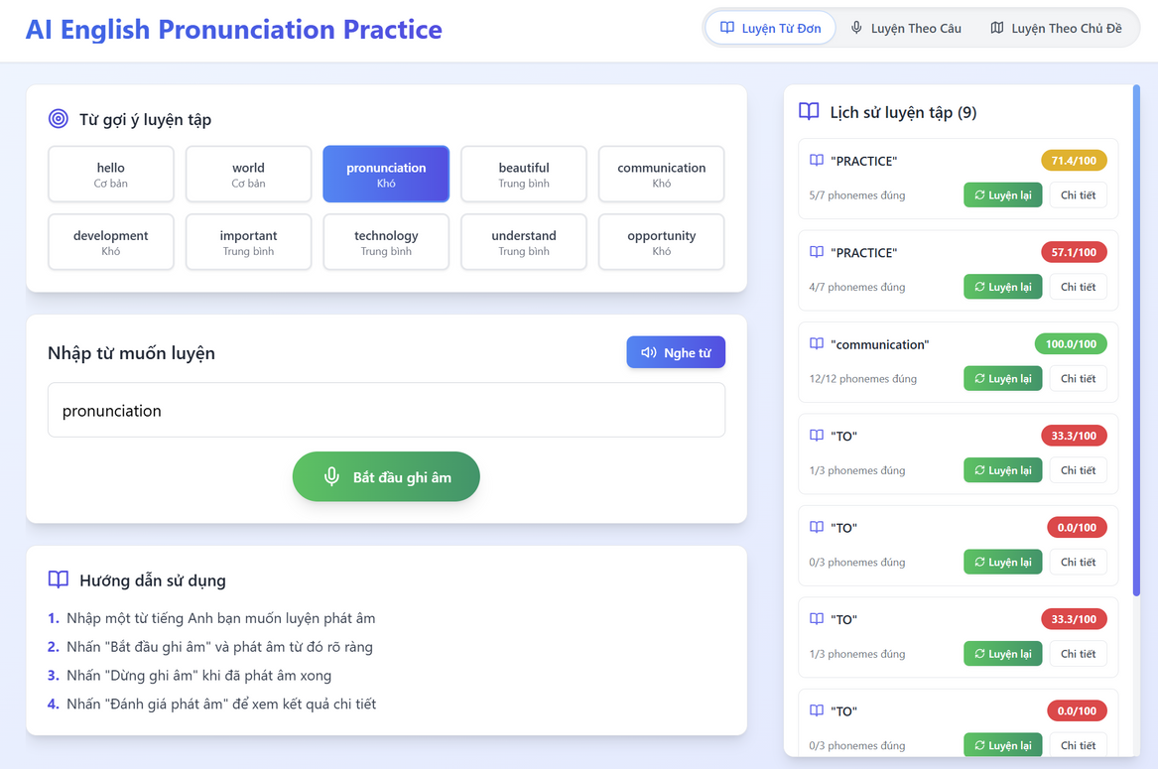
INTRODUCTION
Trang 4/24

Slide 5
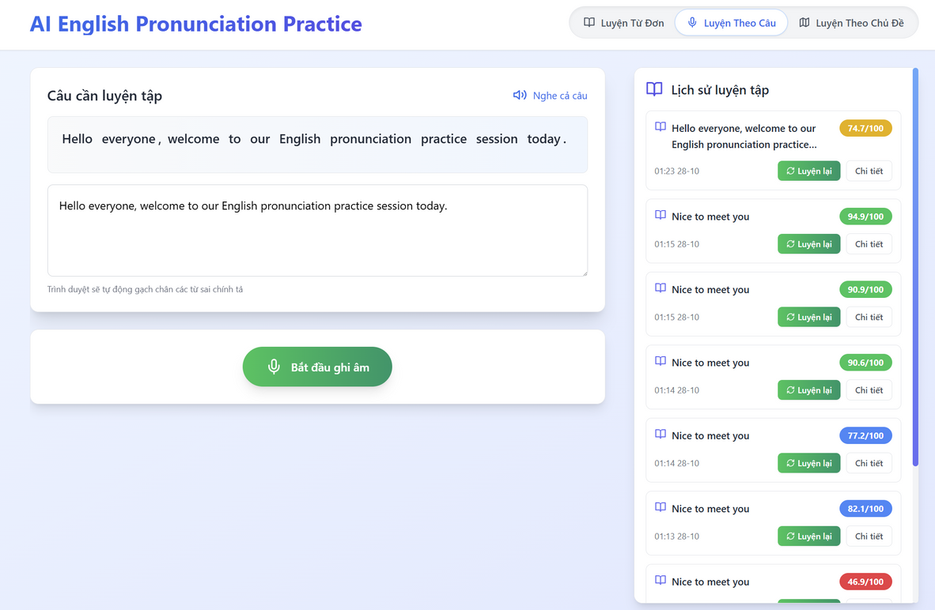
INTRODUCTION
Trang 5/24

Slide 6
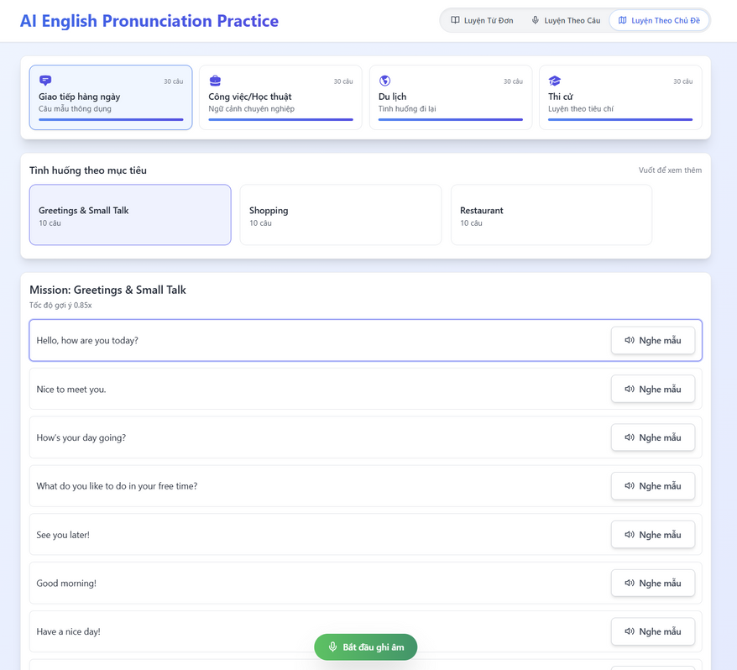
INTRODUCTION
Trang 6/24

Slide 7
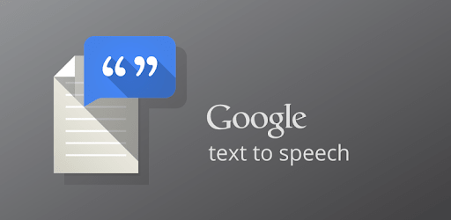
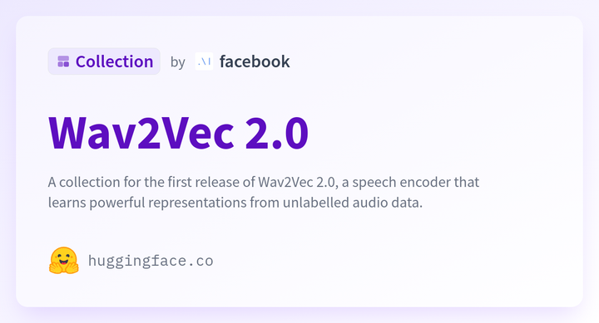


AI MODELS USED
Trang 7/24

Slide 8
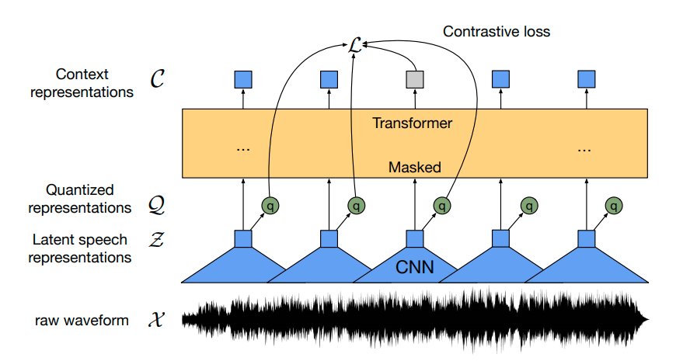
AI MODELS USED
WAV2VEC2
An AI model developed by Facebook AI for Automatic Speech Recognition (ASR)..
Audio Input → Wav2Vec2 Model → Phoneme Sequence Output..
Trang 8/24

Slide 9
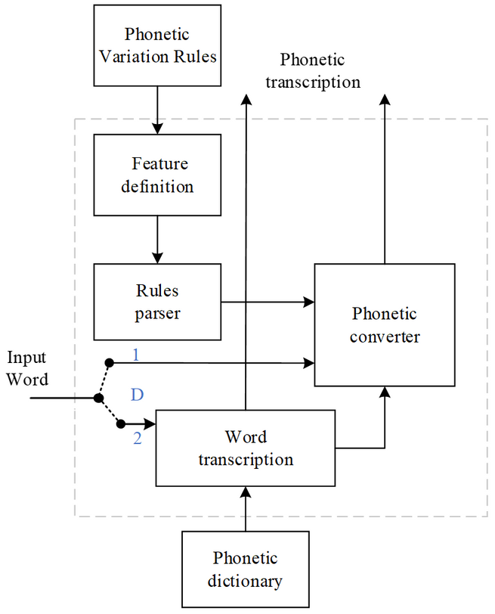
AI MODELS USED
G2P
An algorithm or system that converts a sequence of written letters (graphemes) into its corresponding sequence of sounds (phonemes).
Text (hello) → G2P → Phonemes (HH AH0 L OW1).
Trang 9/24

Slide 10
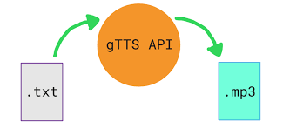
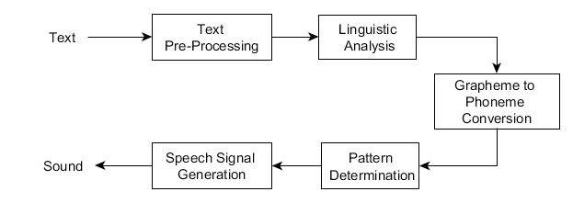
AI MODELS USED
GTTS
A simple Python library that acts as an interface to Google Translate's Text-to-Speech API.
It sends text to Google's servers and receives an audio file (e.g., .mp3) of the spoken text in return.
Very easy to use and supports a wide variety of languages with a natural-sounding voice.
Trang 10/24

Slide 11
AI MODELS USED
INTRODUCTION TO OPENAI WHISPER
Whisper is an open-source speech-to-text model developed by OpenAI.
Converts speech to text with high accuracy across various languages and environments.
Features multilingual recognition and automatic background noise removal.
Applicable in automatic subtitling, meeting transcription, virtual assistants, and language learning systems.
Trang 11/24

Slide 12
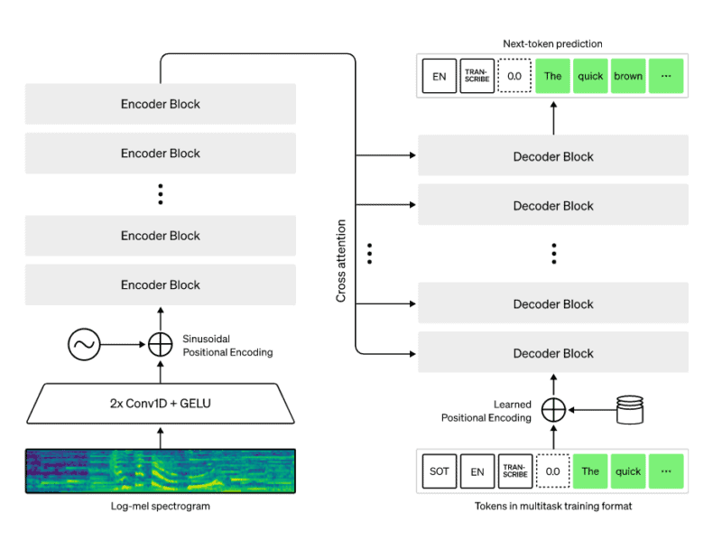
AI MODELS USED
WHISPER MODEL ARCHITECTURE
Based on the modern Transformer architecture, consisting of an encoder-decoder that sequentially processes audio.
Trained on over 680,000 hours of diverse, multi-contextual data, which helps improve its ability to recognize complex speech.
Offered in various versions from small to large, balancing accuracy and processing speed to suit various applications
Trang 12/24

Slide 13
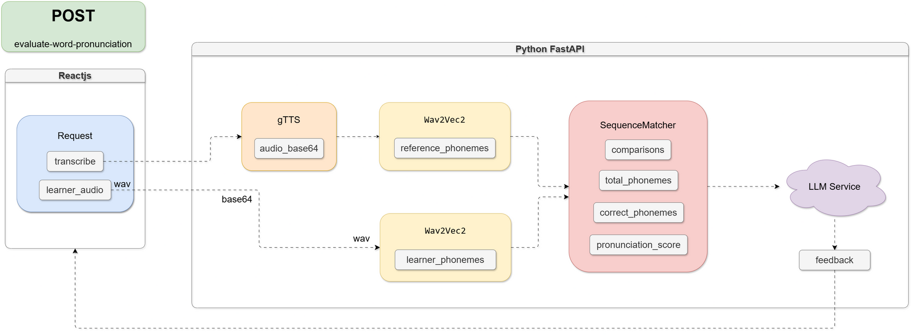
SYSTEM WORKFLOW
One Word Flow
Trang 13/24

Slide 14
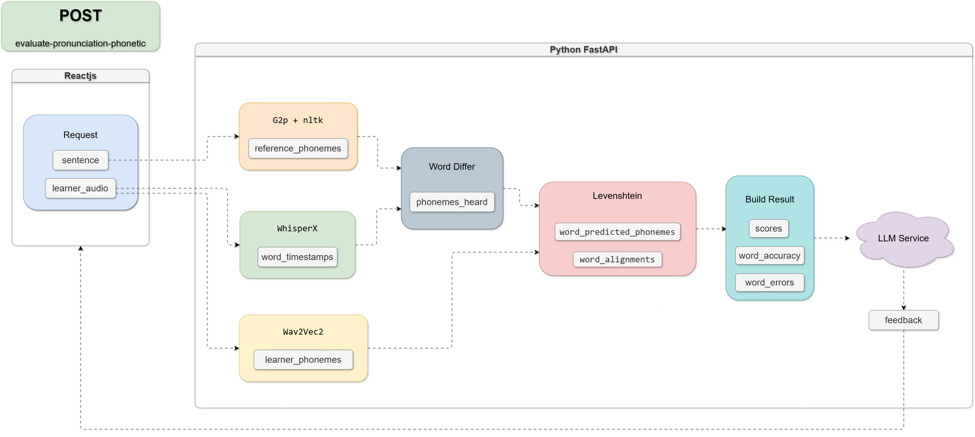
SYSTEM WORKFLOW
Sentence Flow
Trang 14/24

Slide 15
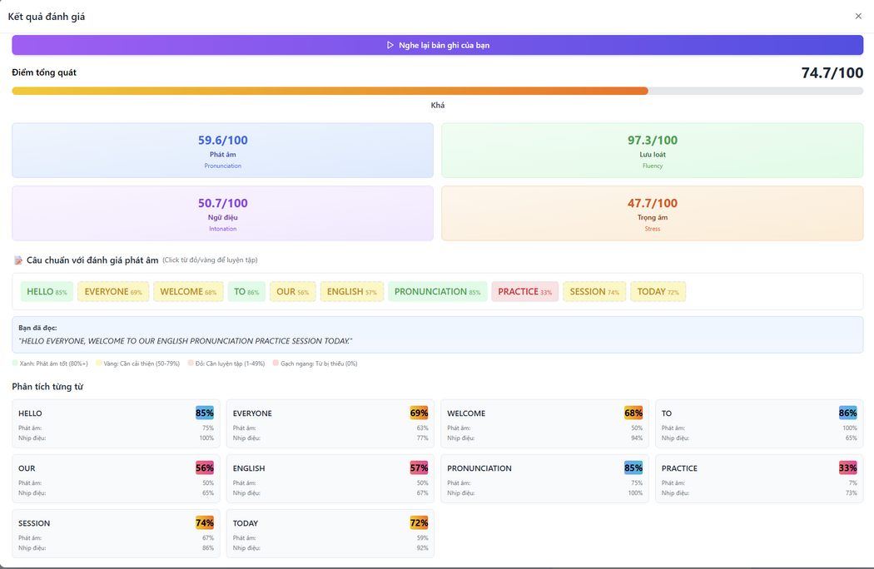
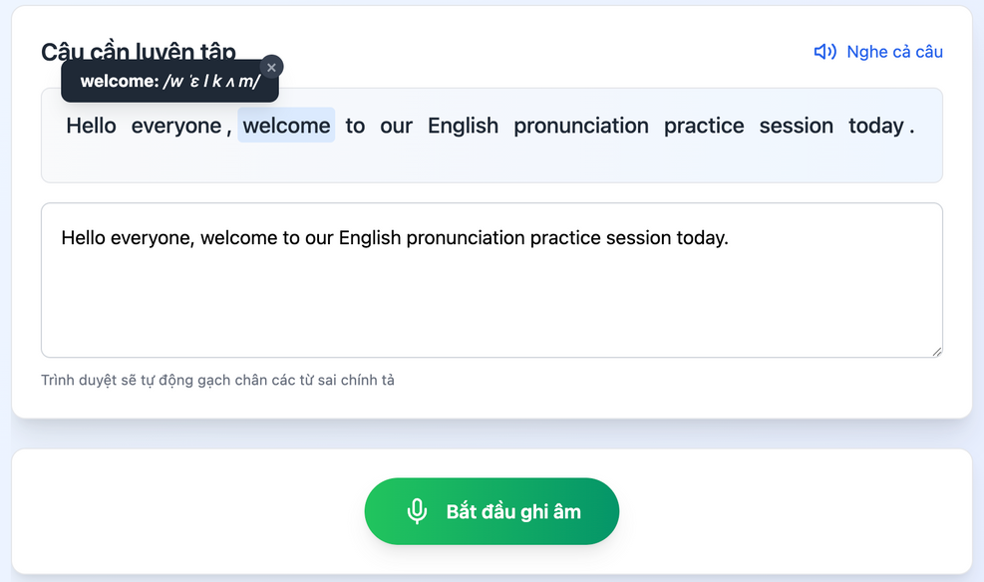
INTERFACE AND FEATURES
OPTIONAL PRACTICE
Trang 15/24

Slide 16
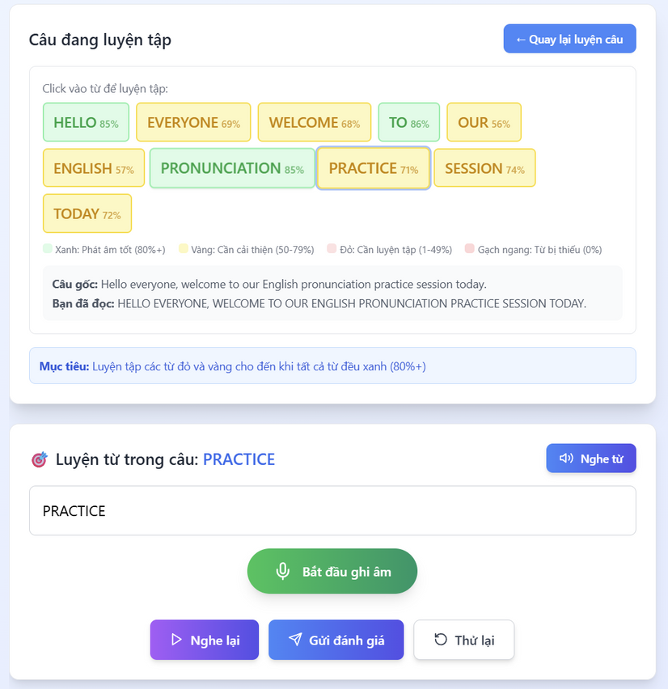
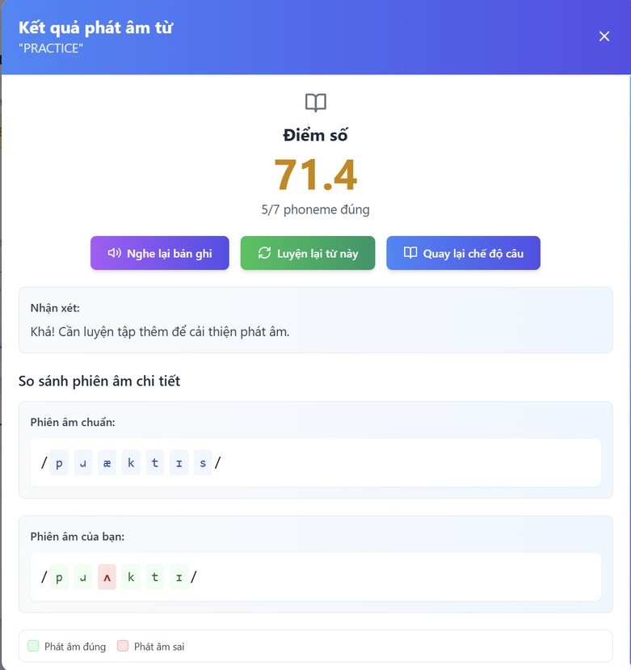
INTERFACE AND FEATURES
PRACTICE SINGLE WORDS
Trang 16/24

Slide 17
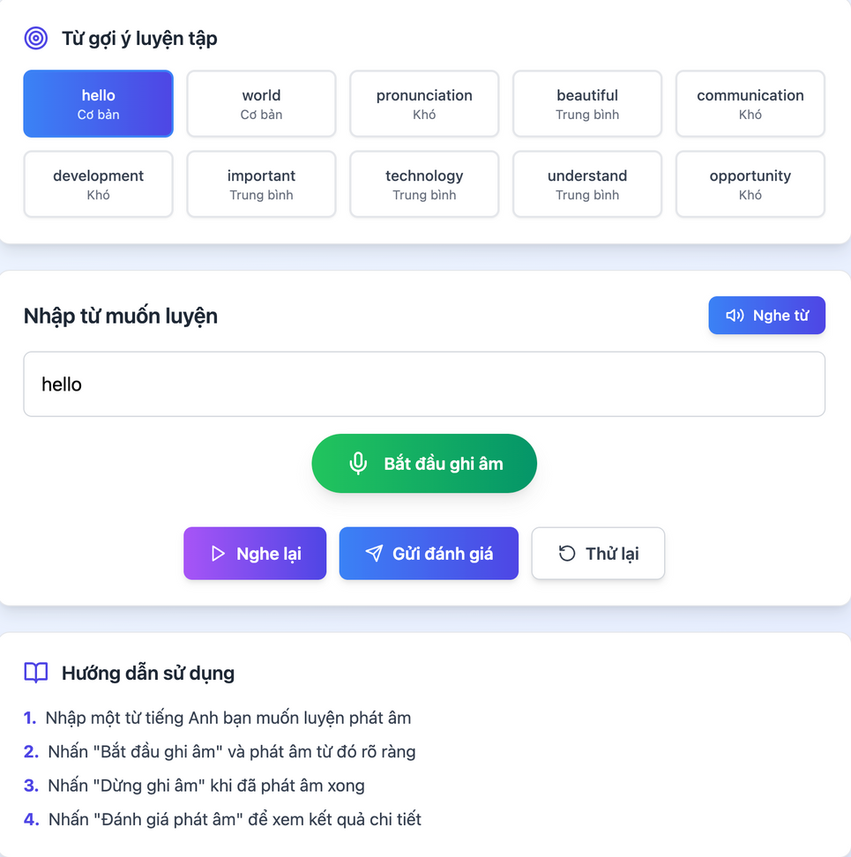
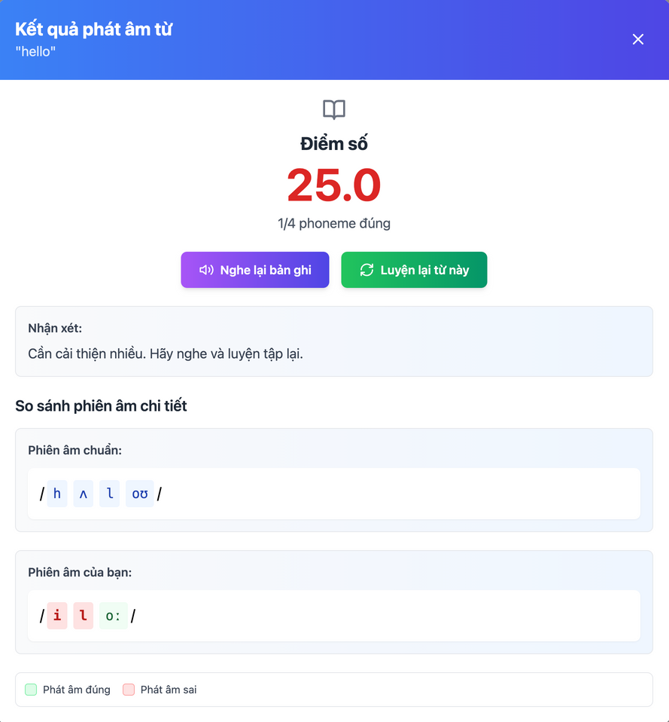
INTERFACE AND FEATURES
PRACTICE SINGLE WORDS
Trang 17/24

Slide 18
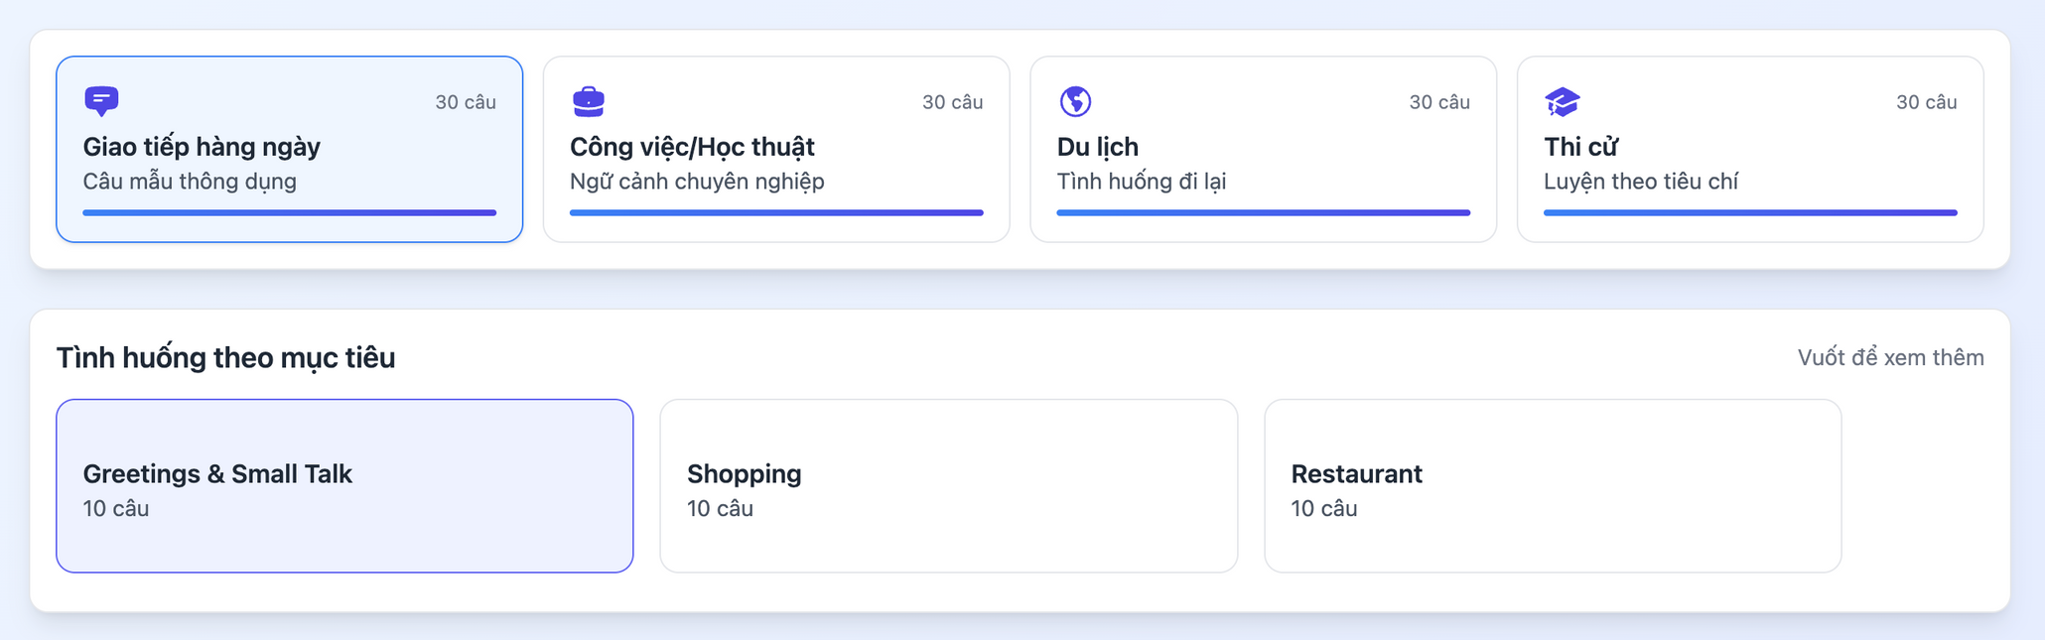
INTERFACE AND FEATURES
PRACTICE BY TOPIC AND SITUATION
Help learners practice a variety of question types
Trang 18/24

Slide 19
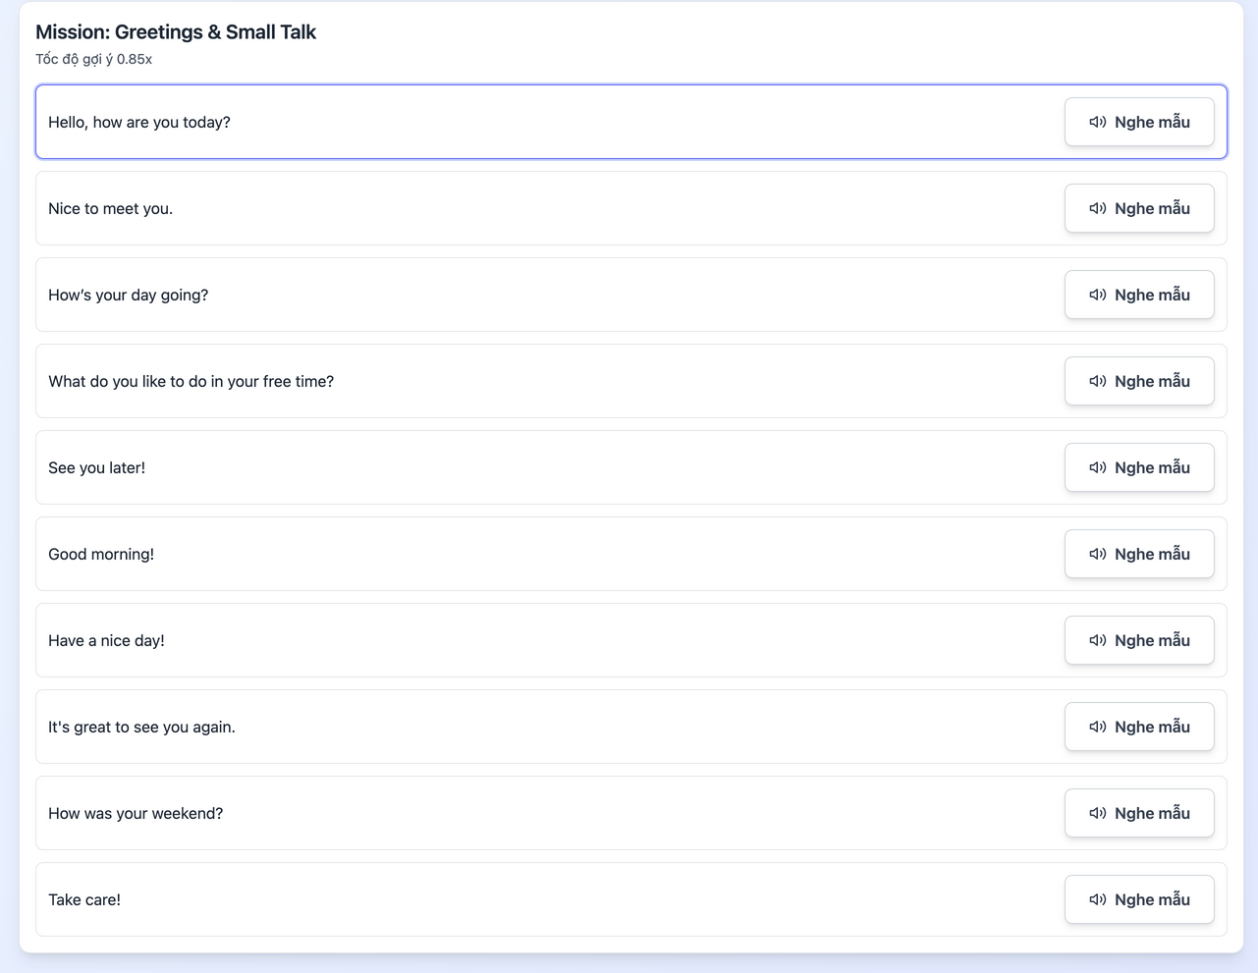
INTERFACE AND FEATURES
SAMPLE QUESTIONS
Questions on the selected topic
Trang 19/24

Slide 20
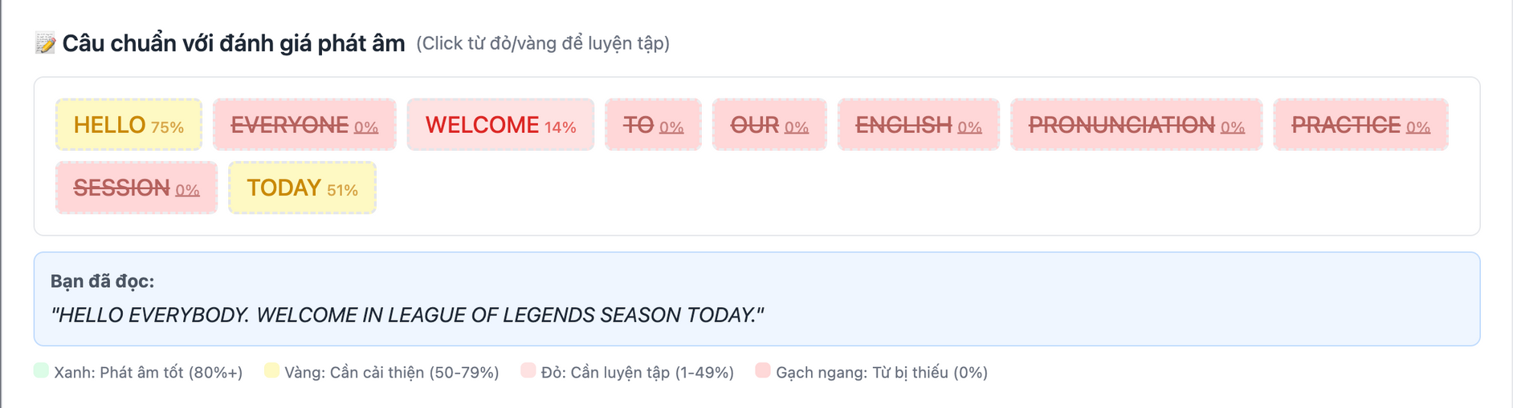
INTERFACE AND FEATURES
ERROR
Trang 20/24

Slide 21
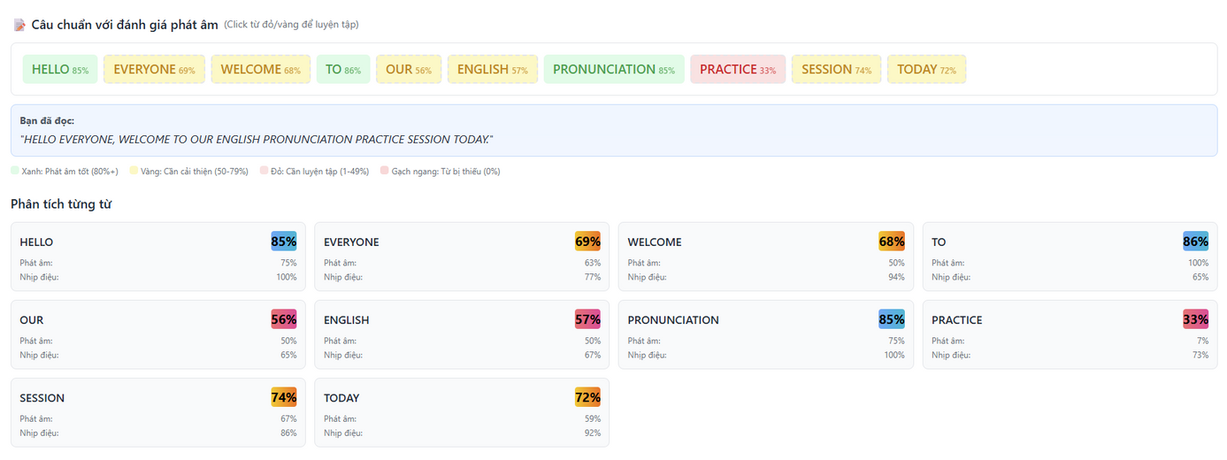
INTERFACE AND FEATURES
SCORE ASSESSMENT
Trang 21/24

Slide 22
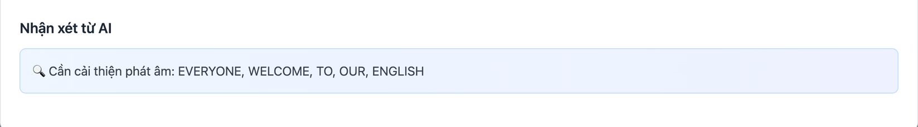
INTERFACE AND FEATURES
COMMENT
Trang 22/24

Slide 23
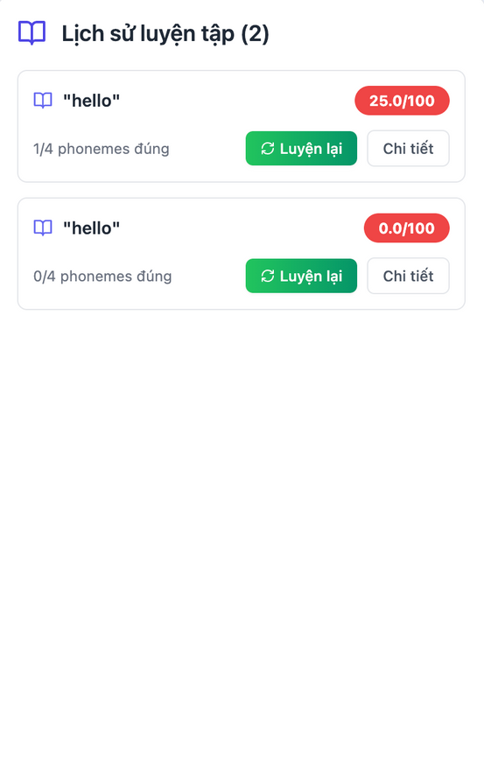
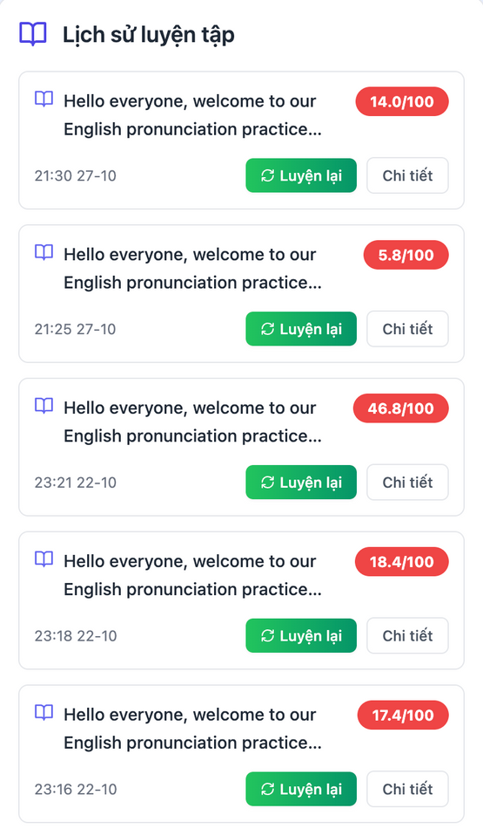
INTERFACE AND FEATURES
TRAINING HISTORY
Trang 23/24

Slide 24
ENGLISH PRONUNCIATION PRACTICE WEBSITE DEVELOPMENT
Project Team:
Nguyễn Tùng Dương
Nguyễn Văn Mùi
Nguyễn Việt Hưng
Nguyễn Văn Sơn
Trang 24/24

